Slide 1

Rendering and animation performance
The road to “WOW!”

Slide 2

DOM is slow

Slide 3
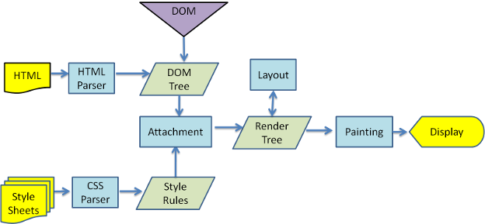
WebKit main flow

Slide 4
Try to make light DOM
Make your application markup as simple as posible.
Use classic patterns for represent a large number of "heavy" visual information.
Create page content from templates.

Slide 5
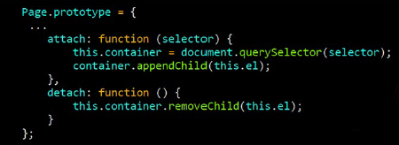
Or

Slide 6
WebKit main flow

Slide 7
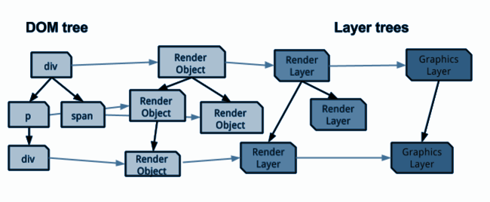
The Compositing Forest (Chrome)

Slide 8
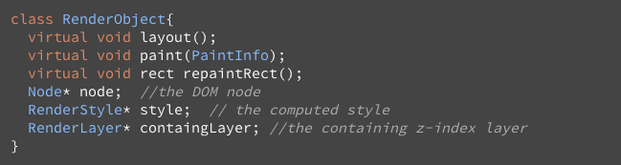
Render Object

Slide 9
Criteria of creation of render layer
It's the root object for the page.
It has explicit CSS position properties (relative, absolute, etc.).
It is transparent.
It has an overflow, an alpha mask, or a reflection.
It has CSS filters.
It corresponds to <canvas> element that has a 3D (WebGL) context or an accelerated 2D context.
It corresponds to a <video> element.

Slide 10
Reflow
Flow model is used.
Lower elements often don’t affect upper elements.
Sometimes you need more than one pass (table, float ...).
Layout process is recursive.
Reflow is called for each layer separately (top, left, width, height).

Slide 11
Reflow types
Initial - during the first pass of tree hierarchy during visualization.
Incremental - in case of any change in the tree frame.
Resize - if you change the size of the boundaries of the region containing the frame-based structure.
StyleChange - only in cases where the change came with the document styles that require a full crawl of hierarchy tree frames.
Dirty - if purification bits are set for the container frame, which indicate that this frame is a child in layouting process.

Slide 12
Reflow
can be async & sync

Slide 13
Reflow pattern
Parent renderer determines its own width.
Parent goes over children and:
Place the child renderer (sets its x and y).
Calls child layout if needed–they are dirty or we are in a global layout, or for some other reason–which calculates the child's height.
Parent uses children's accumulative heights and the heights of margins and padding to set its own height–this will be used by the parent renderer's parent.
Sets its dirty bit to false.

Slide 14
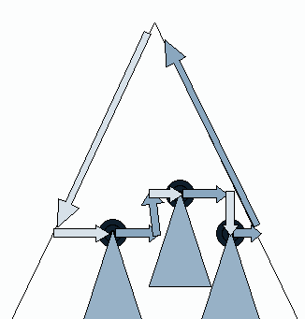
Reflow in picture

Slide 15
Reflow tips
Be careful with properties that may cause reflow, use cached values.
Gather them in one place in the JS code; it allows the browser to perform these operations in batch mode.
If you have frequently changing data, make them a separate layer - for example, by using position: absolute;
var el = document.getElementById('sample');
var w = el.offsetWidth, h = el.offsetHeight;
el.style.width = (w + 10) + 'px';
el.style.height = (h + 10) + 'px';
var el = document.getElementById('sample');
el.style.width = (el.offsetWidth + 10) + 'px';
el.style.height = (el.offsetHeight + 10) + 'px';

Slide 16
Reflow hints
Element
clientHeight, clientLeft, clientTop, clientWidth, focus(), getBoundingClientRect(), getClientRects(), innerText, offsetHeight, offsetLeft, offsetParent, offsetTop, offsetWidth, outerText, scrollByLines(), scrollByPages(), scrollHeight, scrollIntoView(), scrollIntoViewIfNeeded(), scrollLeft, scrollTop, scrollWidth
Frame, Image
height, width
Range
getBoundingClientRect(), getClientRects()
SVGLocatable
computeCTM(), getBBox()
SVGTextContent
getCharNumAtPosition(), getComputedTextLength(), getEndPositionOfChar(), getExtentOfChar(), getNumberOfChars(), getRotationOfChar(), getStartPositionOfChar(), getSubStringLength(), selectSubString()
SVGUse
instanceRoot
window
getComputedStyle(), scrollBy(), scrollTo(), scrollX, scrollY, webkitConvertPointFromNodeToPage(), webkitConvertPointFromPageToNode()

Slide 17
WebKit main flow

Slide 18
Hardware rendering
Layer has a 3D perspective transform or CSS properties.
Layer uses <video>, for video decode acceleration.
Layer uses <canvas> element.
Layer is used for plugins, such as Flash, Java Applet or Silverlight.
Layer uses CSS animations for its opacity or uses WebKit animated transformation.
Layer uses CSS filters.
Layer has a descendant that is accelerated and is transferred to GPU. Render layer contains an "accelerated" child which is not a separate layer!
Layer has a lower relative Z-index, which has a composite (located in GPU) layer (in other words, the layer overlaps the GPU layer)

Slide 19
Hardware vs Software
via calls to the platform-specific 3D APIs (D3D on Windows; GL everywhere else)
vs
via Skia calls

Slide 20
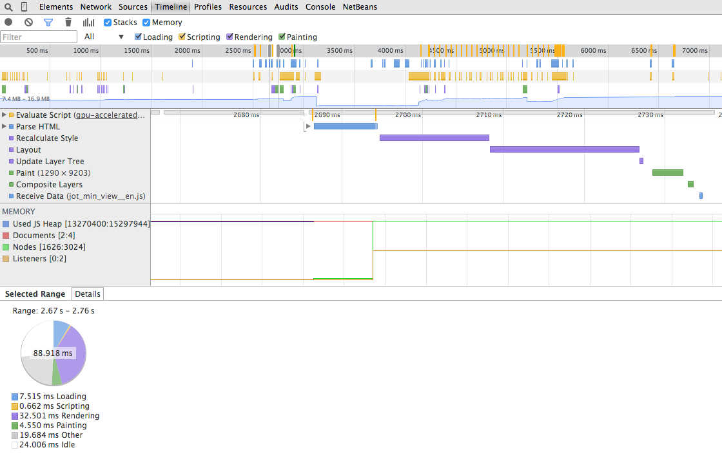
Layers & Rendering

Slide 21
Hardware acceleration problems
CPU operates with DOM-objects, while GPU operates textures.
Transition CPU → GPU always takes time.
When going to GPU, there is always a separate repaint.
Increased memory consumption.
You can "accidentally" transfer unnecessary elements to the GPU.
You cannot speed up everything for the third reason.

Slide 22
Animation Performance Tips
Animate elements with position: absolute (as the individual layers).
Use GPU-animation.
Be sure that you transferred animated layers to GPU before animation (translate3d (0,0,0) and translateZ (0)).
Try to use CSS Transitions / Animations.
Do not transfer from CPU to GPU inside a layer.
Keep as few elements as possible in the DOM tree.

Slide 23
Repaint
there is global and incremental

Slide 24
The sequence of drawing
Background color of the element.
Background image.
Border of the element.
Its children.
Circuit of the element.

Slide 25
Browsers are smart
if you have dynamic changes.

Slide 26

Use simple styles

Slide 27
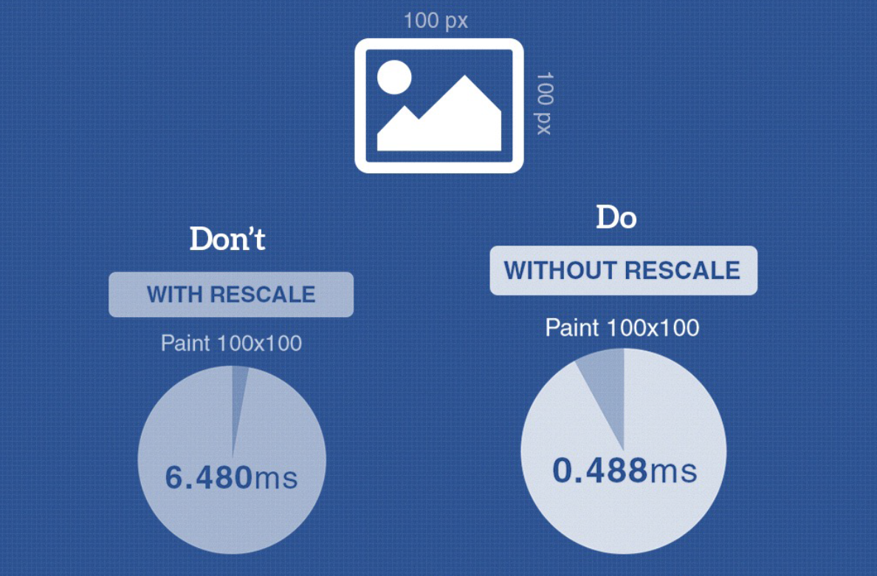
Don’t rescale image

Slide 28
Optimization criteria of repaint
Redrawing area
Number of redraws
Time when it occurs

Slide 29
Tools
Show paint rectangles.
Show composited layer borders.
Show FPS meter.
Enable continuous page repainting.
Show potential scroll bottlenecks.

Slide 30
What to do
Minimize redraw of the page parts.
Track FPS.
Minimize the number of redraws.

Slide 31
New..
Virtual DOM
Incremental DOM

Slide 32
Checklist
Remember that reflow and rendering are one of the heaviest operations in the browser.
Keep DOM as little as you can.
Try to make a separate render layer for frequently changing data.
Animate elements with position: absolute (separate layers).
Use GPU for animation.
Move animated layers to GPU (translate3d(0,0,0) and translateZ(0)) beforehand; and don't change the content during the animation.
Try to use CSS Transitions/Animations.
Don't create CPU animations inside the GPU layer.
Gather operations with DOM in one place.
Cache the data received from DOM.
Use CSS styles without shades and semitransparencies, if possible.
If possible, don't change image sizes.

